Slide 1
Introduction To Data Analytics With Pandas On Data Science Experience
Kunal Malhotra -- kunal.malhotra1@ibm.com -- @kunal_forever

Slide 2
Agenda
What is Data Analysis?
Introduction to pandas.
Advantage of pandas over other available solution.
Advantage of using Data Science Experience for data analysis.

Slide 3
Question
The process of systematically applying techniques to evaluate data is know ?
Data Munging
Data Analysis
Data Science
Data Bases

Slide 4
Introduction To Data Analysis
What is it?
Apply logical techniques to describe, condense, recap and evaluate data and illustrate information.

Slide 5
Goals Of Data Analysis
Discover useful information.
Provide insights.
Suggest conclusion.
Support Decision Making.

Slide 6
Introduction To Pandas
Pandas is a python package for data analysis.
It provides built-in data structures which simplify the manipulation and analysis of data sets.
Pandas is easy to use and powerful. Remember with great power comes great responsibility.
http://pandas.pydata.org/pandas-docs/stable/

Slide 7
Pandas: Essential Concepts
Series:- A Series in pandas is a one-dimensional labeled array capable of holding data of any type (int, string, float, python objects etc.)
DataFrame:- A Data Frame is a two dimensional structure, i.e., data is aligned in tabular fashion in rows and columns.
Panel:- A Panel is a 3D container of data. The 3 three axis in the panel are represented as:-
Items:- axis 0, each item corresponds to a DataFrame contained inside.
Major_axis:- axis 1, it is the index(rows) of each DataFrame.
Minor_axis:- axis 2, it is the the columns of each of DataFrame

Slide 8
Advantage Of Pandas
Pandas have a lot advantage over other solutions such as NumPy, CSV and JSON packages in python, Sql etc.
A NumPy array requires homogenous data. With a pandas DataFrame, you can have different data types(int, float, string, datetime etc.) all in one place.
Good IO capabilities i.e. data can be pulled directly from databases into a dataframe.
Pandas has built in functionality for a lot of common data-processing applications: for example, easy group by syntax, easy joins (which are also really efficient in pandas), rolling windows.

Slide 9
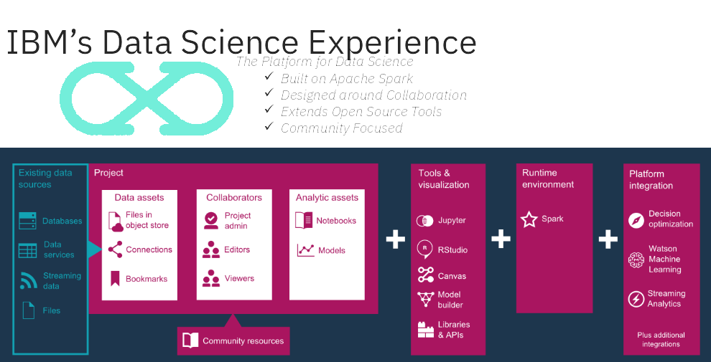

Slide 10
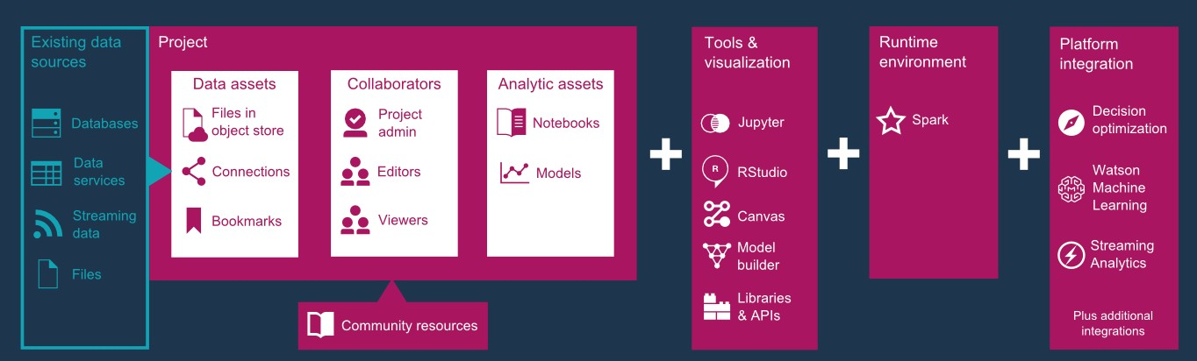

Slide 11
Advantages Of DSX For Data Analyses.
IBM DSX is IDE (Integrated Development Environment) over the cloud providing a lot of advantages such as:-
Offering easier access to large amounts of data while decreasing the total time of analysis.
Rapid development experience with access to tools and utilities that break down language barriers.
The IDE already supports open source tools from IBM and others including H20 Libraries, RStudio, Python and Notebooks in single environment.
Ability to integrate and connect to multiple data sources, refining, and accessing big data engines.

Slide 12
Enough! Let’s Code Something
May the force of pandas be with you :)

Slide 13
Step 1

